Slide 1



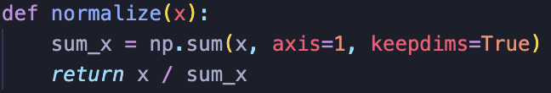
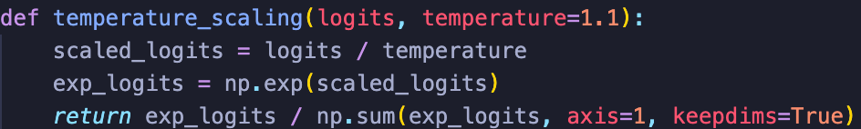
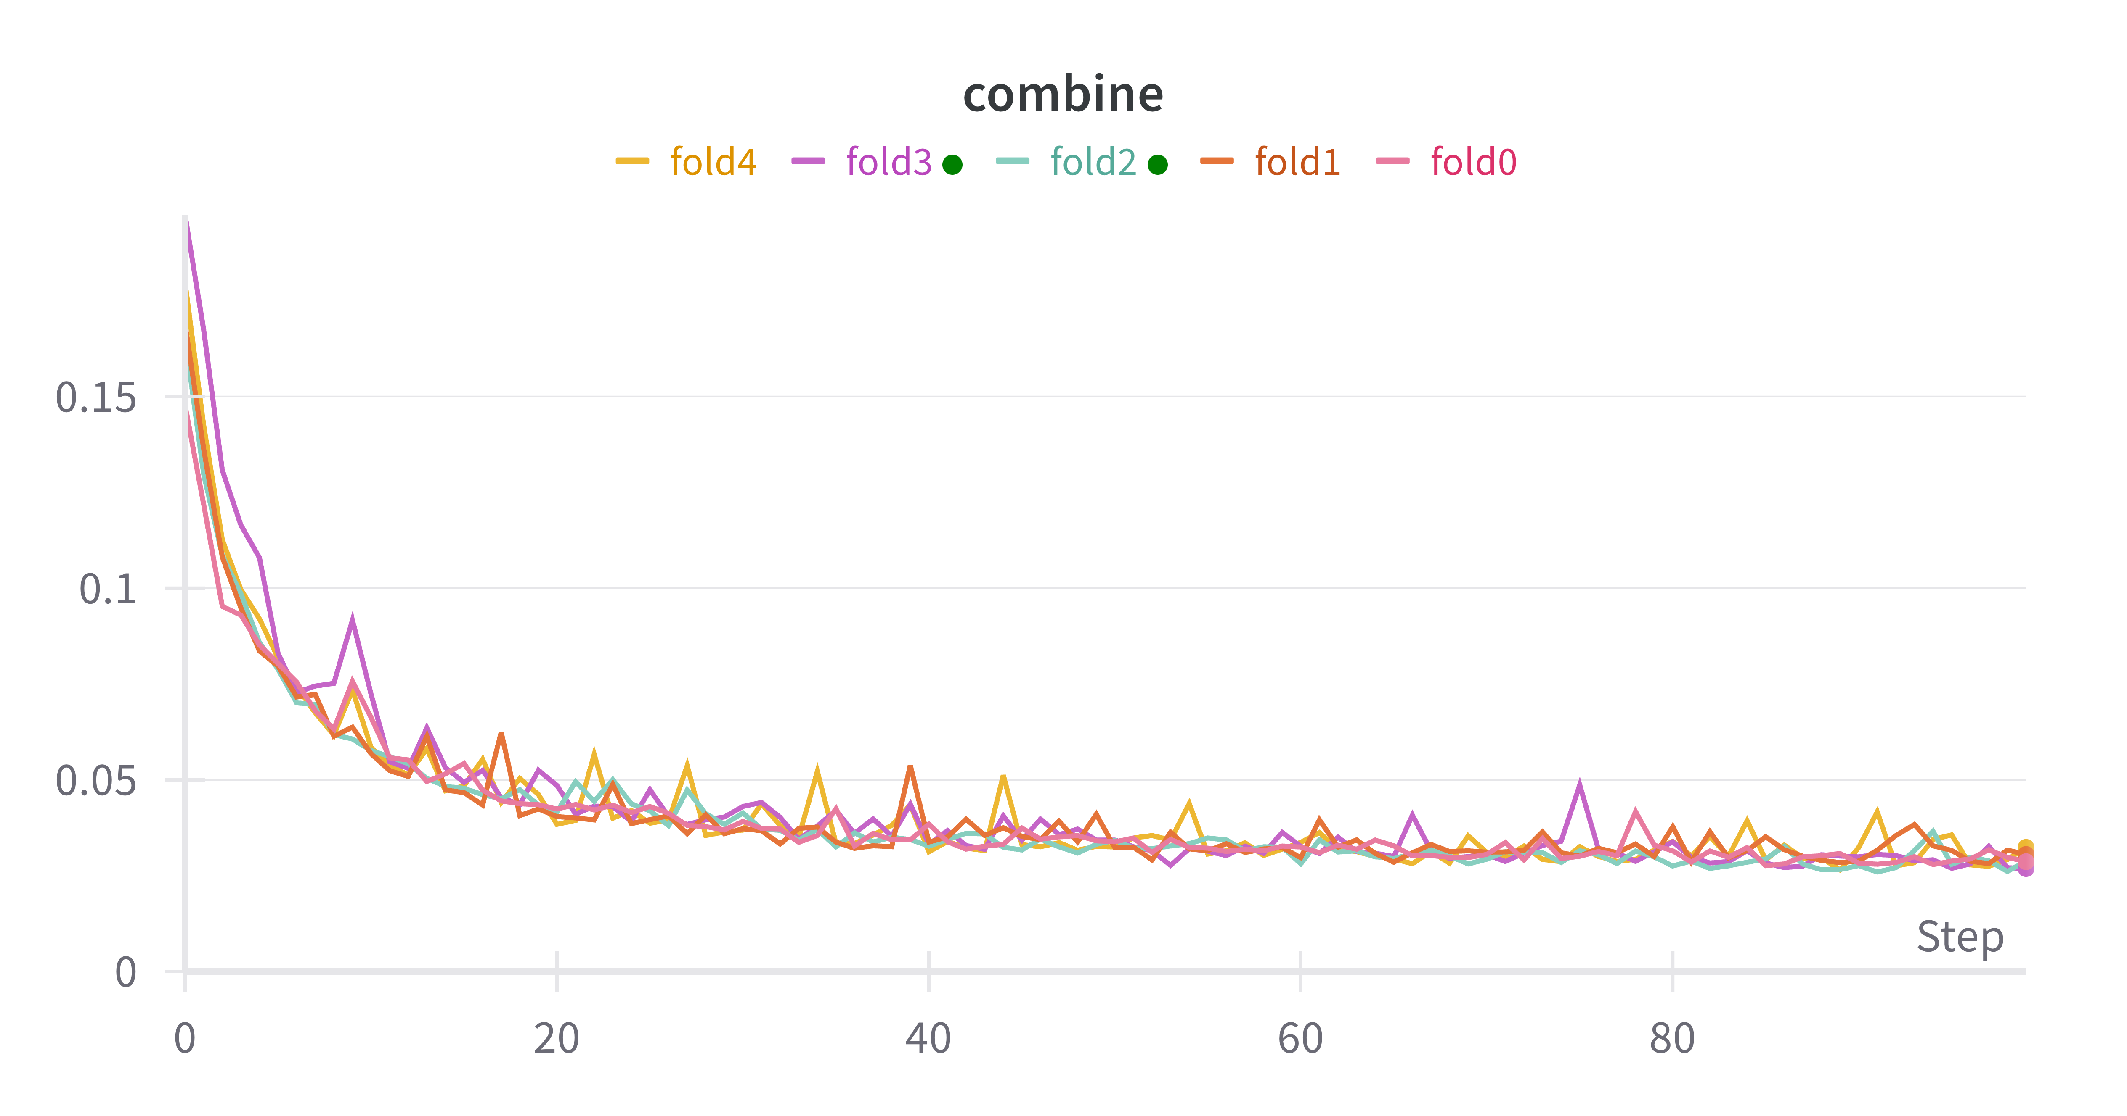
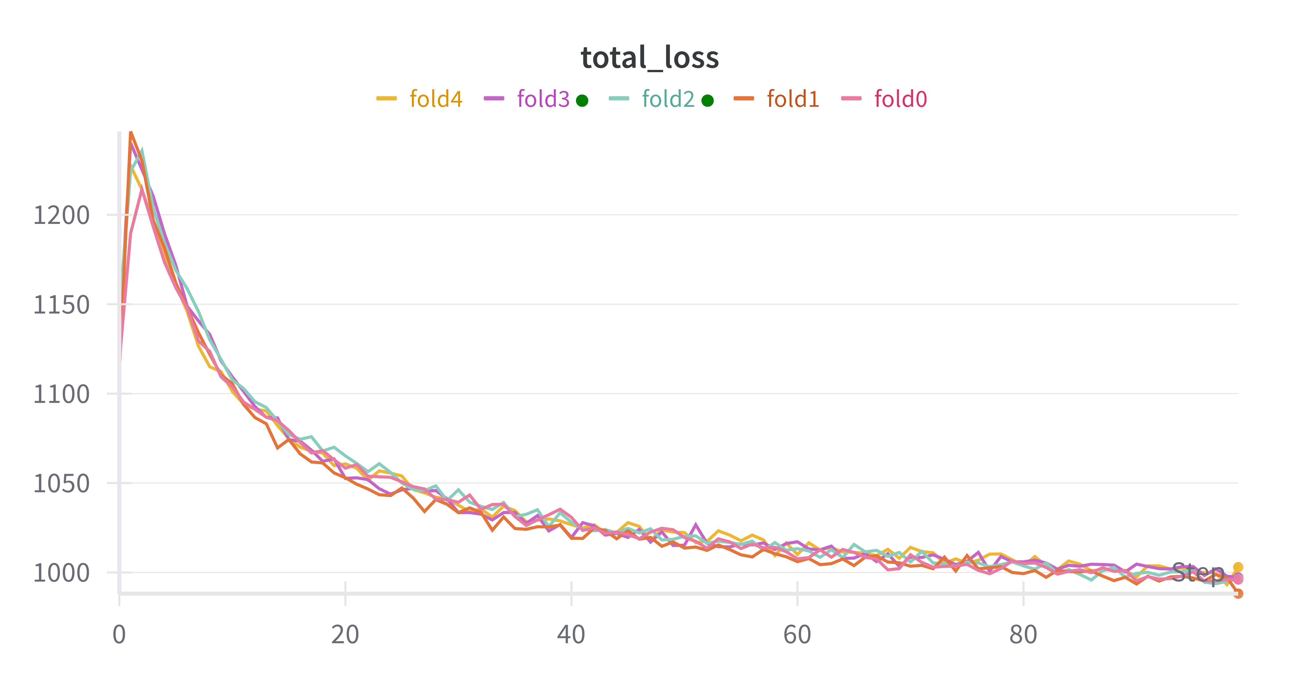


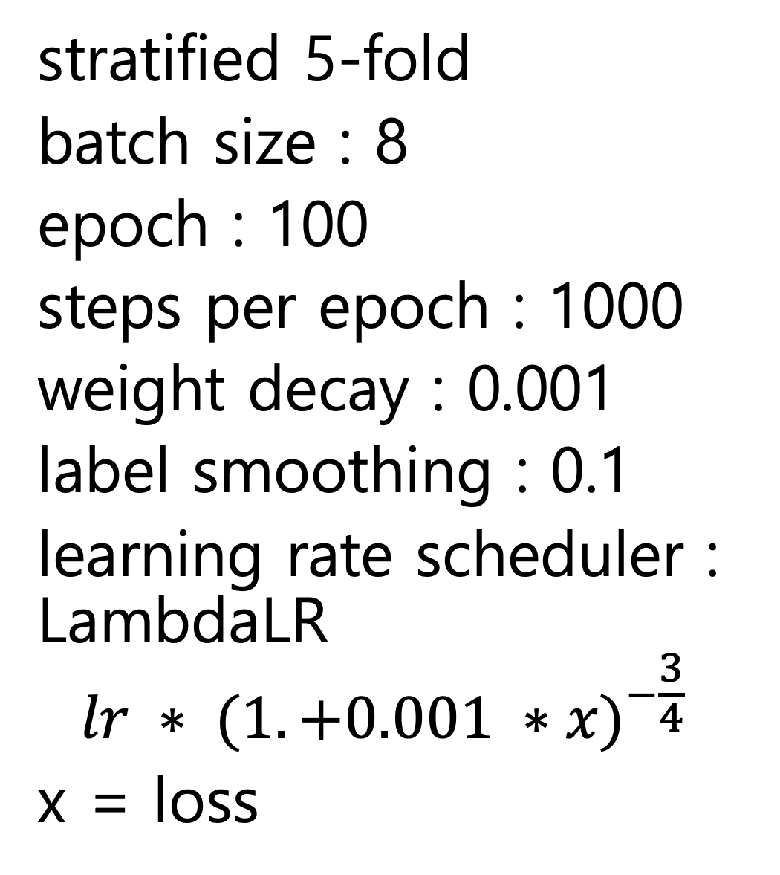
김준영, 김정우, 박상혁
AASIST
(Fold0)
◇ Inference
◇ Multi-label Classification
multi-label classification을 위해 AASIST모델을 사용하였고 Domain adaptation을 위해 Smooth Domain Adversarial Training기법을 활용했습니다.
sampling
rate
16000
s = the number of speaker
else
AASIST
(Fold1)
soft
voting
if s == 1
normalize
$$\frac{x+0.5}{2}$$
pyannote
speaker-diarization
3.1
AASIST
(Fold2)
speech
0
AASIST
(Fold3)
if s == 2
temperature scaling * 4/3
$$\frac{x+\frac{2}{3}}{2}$$
fake : 0
real : 0
AASIST
(Fold4)
First
Step
Train
data
wave
form
16000
AASIST
Train
data
last
hidden
state
Classification
(Only Linear)
160 -> 2
fake
BCE
With
Logit
Loss
label
Adam
(AASIST)
real
Train
data
wave
form
16000
AASIST
Train
data
last
hidden
state
Classification
(Only Linear)
160 -> 2
fake
BCE
With
Logit
Loss
label
Second
Step
real
Unlabeled data
wave
form
16000
Unlabeled data
last
hidden
state
Adam
(Discriminator)
+
SAM
(AASIST)
Discriminator
(Linear + ReLU)
trade_off
stratified 5-fold
batch size : 8
epoch : 100
steps per epoch : 1000
weight decay : 0.001
label smoothing : 0.1
learning rate scheduler : LambdaLR
$$lr ∗ {(1. +0.001 ∗x)}^{−\frac{3}{4}}$$
x = loss
Gradient
Reversal
Layer
Conditional
Domain
Adversarial
Loss
김준영 | befinetuning@gmail.com | 010-9267-8050
김정우 | qnq314@gahcon.ac.kr | 010-5585-4632
박상혁 | seollal25@gachon.ac.kr | 010-4014-1871

